Slide 1

Community Wish List

Slide 2
Background
Why did we run the survey?
  Capacity and funding in place
  We needed community feedback on project ideas so we were focused on what the community wanted
June to July 15 – sent out our initial list of ideas and asked for more
July – consolidated ideas into groupings that corresponded to City of Kelowna department areas because we will HAVE TO work with the City on the vast majority of the wish list
July to September – ran the Community Wish List Survey
Notes:
The Community Wish List survey was run because the Board had the funds and experience to take on new projects. The processes with FireSmart, the garage sale and other community projects were now “process improved” and established…so the Board wanted feedback on what the community wanted us to focus on.
We started out with an initial list of ideas that the current and past Boards have kicked around and we went out to the community for more ideas.
We were blown away with the number of ideas that we received!
To deal with the sheer number of ideas, and variations of ideas, Laura decided to group the ideas into similar areas that matched up with various City of Kelowna departments…because we KNOW that most of the projects will have to include working with and approval from the City of Kelowna.

Slide 3
Outcomes … are statistically significant!
108 surveys – this represents 11.25% of all households in Quail Ridge
Pretty good representation across age cohorts
Notes:
With a population of 960 households, 108 surveys give us a 11.25% sampling…which is statistically significant.
And, the respondents are roughly spread across the 3 main areas of the community: Quail Run, Capistrano and the strata complexes on Country Club Blvd.
And…there is a good representation across age cohorts. Yes, there are more in the 60 and 70 year old age cohort…but that IS what our area is like. It is a retirement community, with some younger families and university students that live here too.
We did have 15% not provide age data, which is fine. The question wasn’t mandatory.
BUT… the question was not irrelevant because if we want the City listen to us, the results had to be statistically significant. ☺

Slide 4
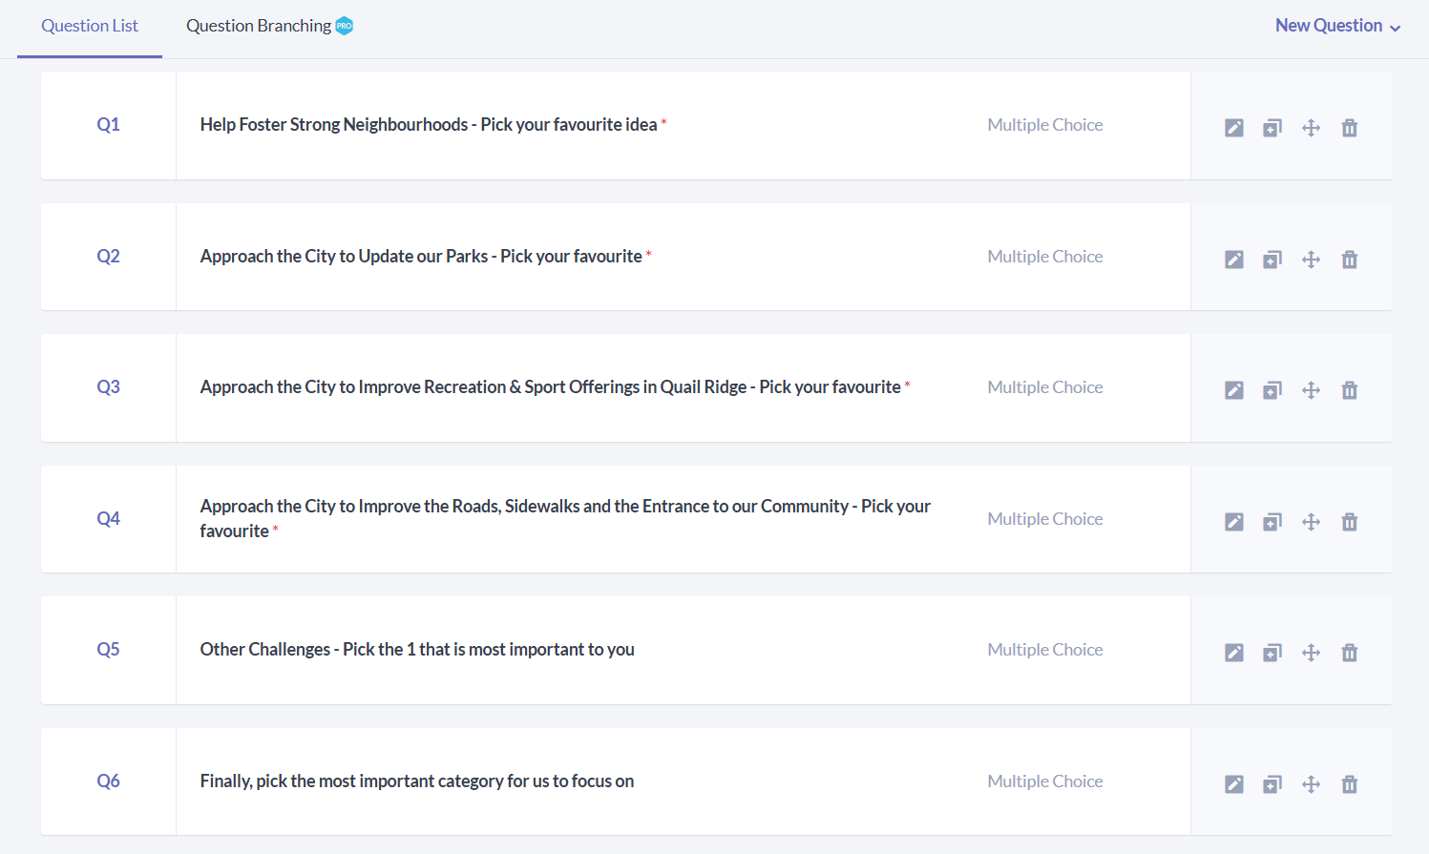
The Survey Questions
Notes:
5 main questions and one final question to identify which area was the more important.

Slide 5
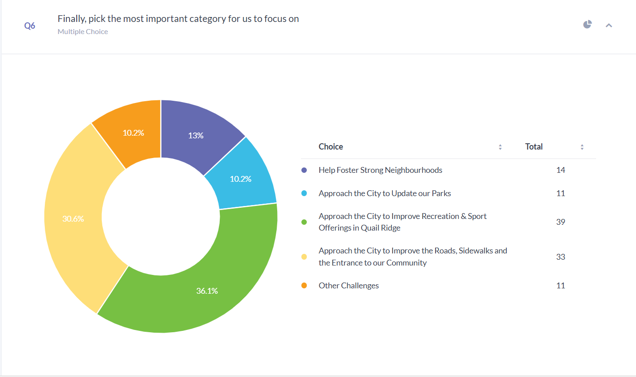
#1 Choice: Approach the City to Improve Rec & Sports!
Notes:
#1 was approaching the City to Improve Recreation and Sports Offerings in the area! A close second was around approaching the City about the roadways, sidewalks and entrance to the community. Distant 3rd ,4th and 5th are fostering strong neighbourhoods, updating our parks and the “challenges”.
This had Laura abit confused at first but it sort of hit…we have an extremely strong neighbourhood to start off with. We have 243 members…which is a good percentage of the 960 households up here. And, the Parks questions were more around FireSmart activities…which are also well established practices up here.
So the message is if you’re going to focus on something new, let’s focus on sports and recreation and the our roads, sidewalks and community entrance!

Slide 6
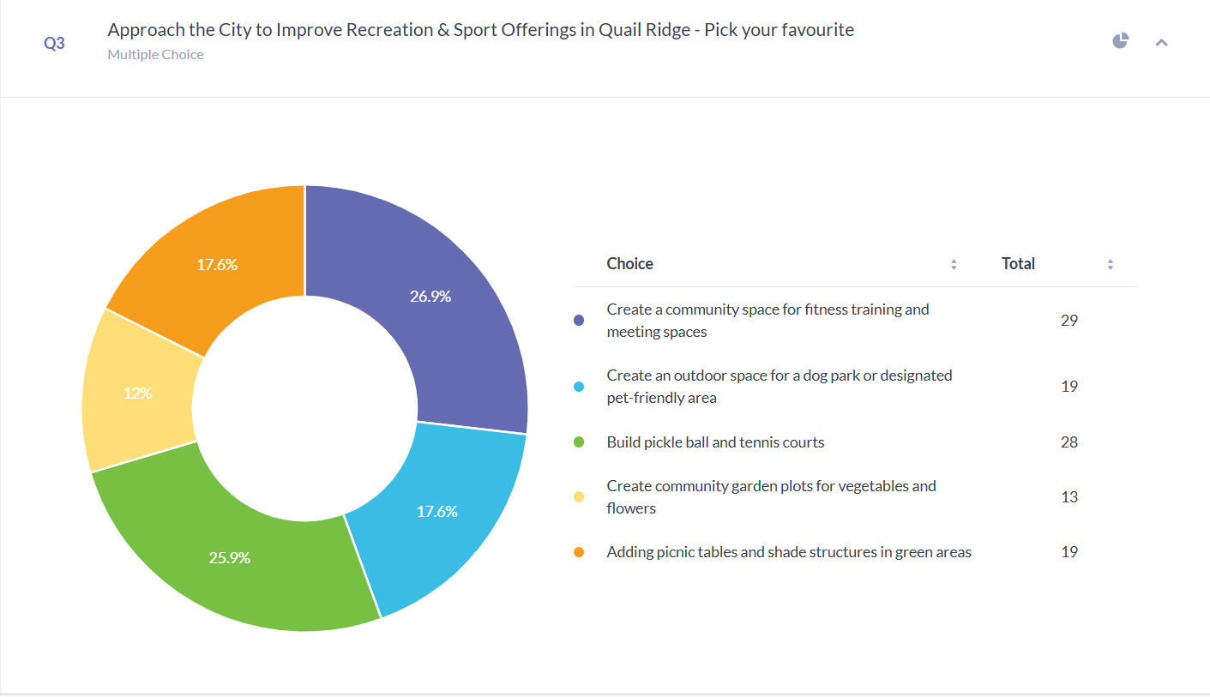
Tied: Community Space + Pickleball / Tennis Courts for top picks
Notes:
In the sports and rec category, Laura watched the survey over the time period and it flipped back and forth between pickleball / tennis courts to creating a meeting place for sports and fitness.
Laura cautioned everyone that the City has long term plans in place and that the association may not be able to do anything in this regard. These types of facilities are big capital expenditures.
But the Association will talk with the City.

Slide 7
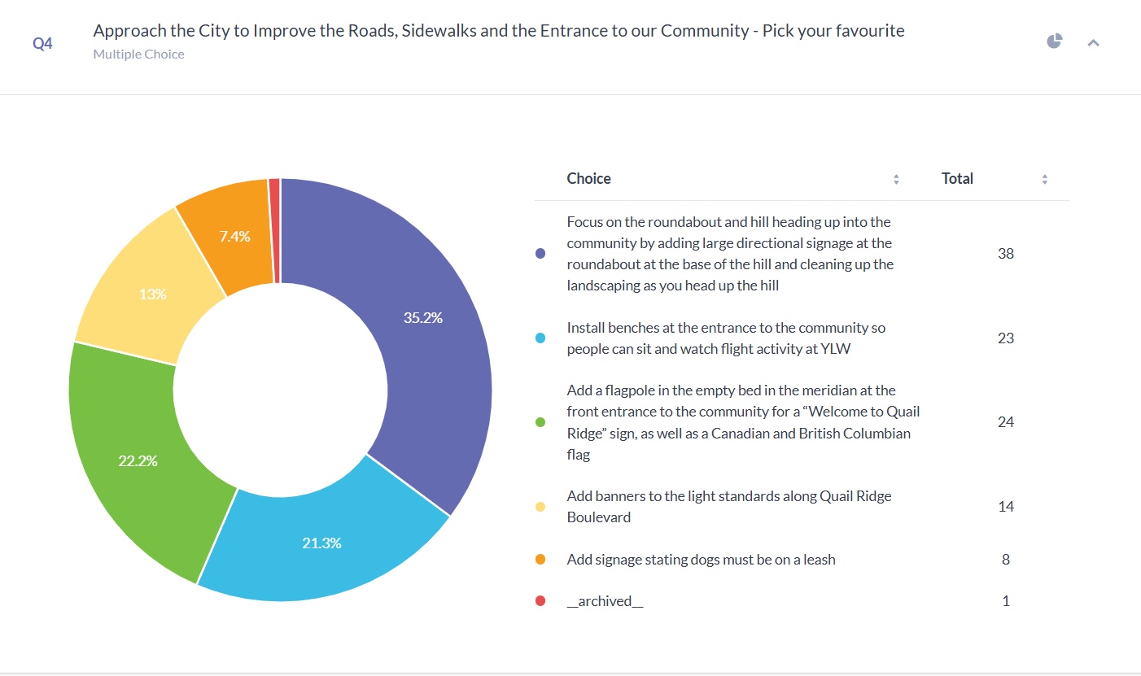
#2 Choice: Approach the City about Roads, Sidewalks and Community Entrance
Notes:
The #2 spot in the survey went to approaching the City about our roads, sidewalks and the community entrance at the base on the hill. The #1 area of interest in this category was around getting some signage in the roundabout at the base of the hill and cleaning up the weeds on the sidewalk side of the roadway.

Slide 8
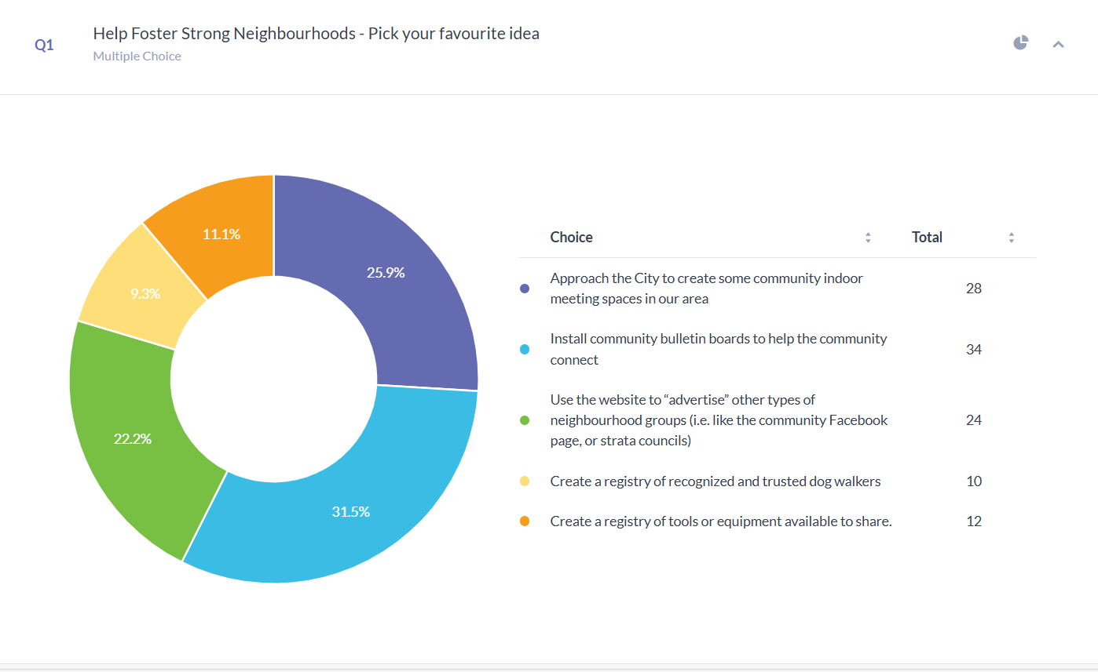
#3 Choice: Foster Strong Neighbourhoods
Notes:
#3 choice was around fostering strong neighbourhoods. And as discussed, this category garnered a far lower ranking than the recreation / sports offering as well as the entrance to the community and this is likely because we have a mature program already. So, we will continue on our bulleting board project and the work with our website.

Slide 9
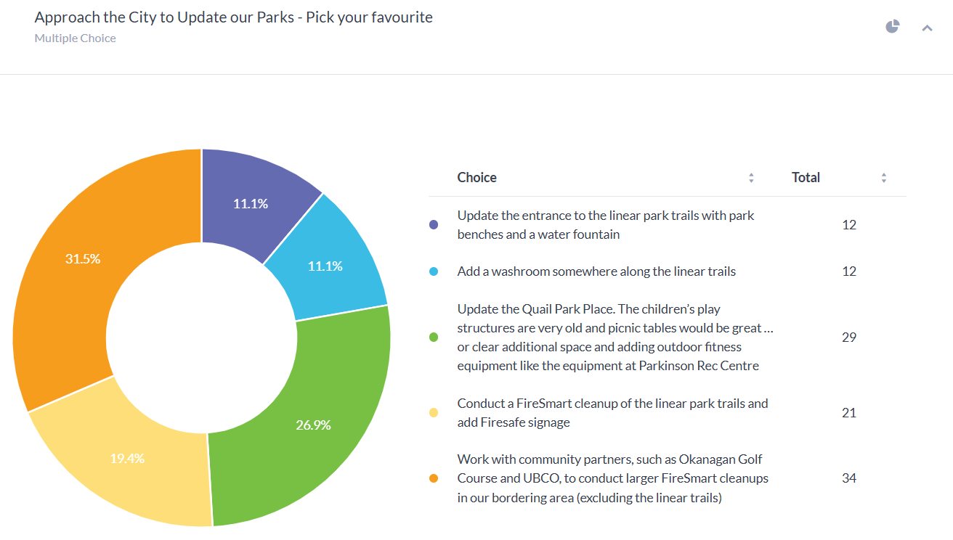
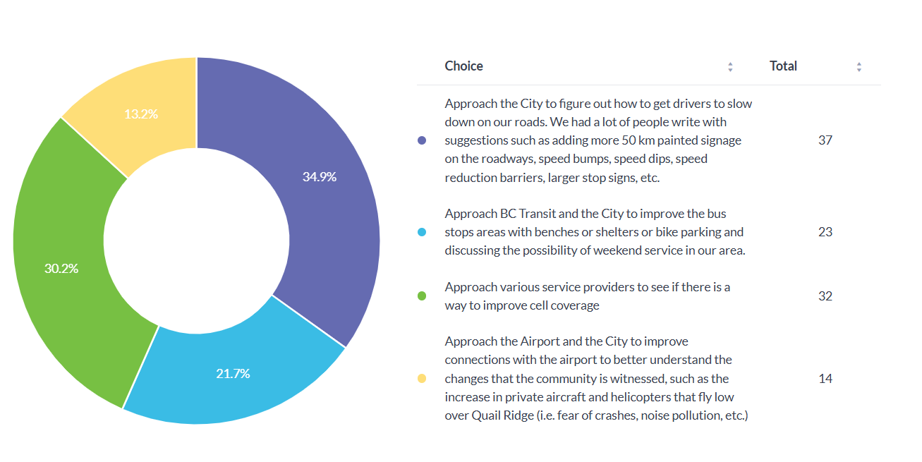
#4 Choice: TIED – Other Challenges and Update our Parks
Notes:
The last 2 spots go to updating our parks and the big challenges we all face.
As we said in the original survey about the challenges, we will bring these forward but we have no expectation that our little residents’ association can do much to improve the traffic situation much less improve cell coverage.
And…we will continue our FireSmart efforts…heck, the suggestions for the Quail Park Place for fitness equipment like the outdoor equipment at Parkingson Rec sort of falls under the Sports and Recreation category too.

Slide 10
Next Steps…
Caveat: We can’t guarantee that any of these ideas are actionable.
Will start discussions with City of Kelowna about traffic, working with UBCO and Okanagan Golf course about FireSmart initiatives
Will continue working on community bulletin boards
Have already started talking with City about community entrance and pickle ball and tennis courts!
Manage expectations: For City projects, expect that this will entail future City of Kelowna surveys and community involvement

Slide 11
Pickle ball and Tennis Court idea from community!
An idea from the community for courts being built just west Quail Ridge Boulevard, right at the roundabout (across from Tesla)
So … no noise next door!
Hard up here because limited public lands for development
But this area is zoned P3 (not inside Agricultural Land Reserve)
Notes:
This is an example that came from the community! Gord Walker brought it forward to our Strong Neighbourhood’s lead, Mandy Pollard, who in turn is discussing it with Parks and Recreation.
We have NO idea if this type of development is even possible. But! It is creative and we loved that fact that someone in the community put a larger package together with this idea.
It is a great way to open the dialogue with Parks and Recreation.

Slide 12
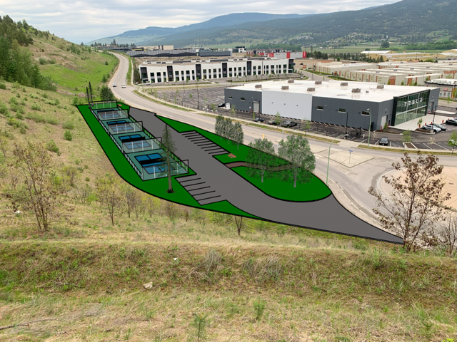
Pickle ball and Tennis Court idea from community!
Notes:
Isn’t this smart!

Slide 13
Pickle ball and Tennis Court idea from community!
Absolutely no guarantees on these plans for the courts … but it is being discussed!
Thank you!!!

